Slide 1
TerrariaClone Review
By George H, Matt G, George D,Jeremiah O,
Sanchez E and Sam K

Slide 2
Introduction
What is Code Review?
Why do we use it?
When do we use it?

Slide 3
Tools
SonarQube
ECL Emma
Manual Analysis

Slide 4
Duplicate Code
Define the constant instead of duplicating the code.
REFRACTOR METHODS

Slide 5
Coverage
33.9% coverage instead of 70%

Slide 6
Syntax
.equals should have been used instead of ‘==‘

Slide 7
Never Ending Loops

Slide 8
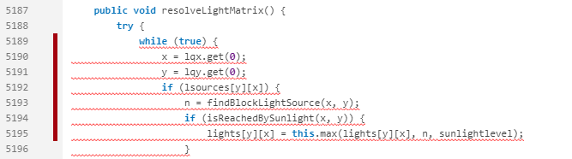
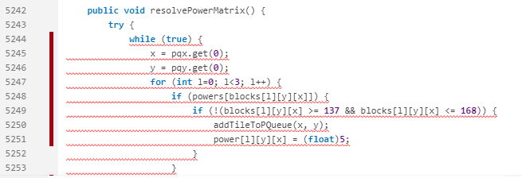
Broken Loop declaration

Slide 9
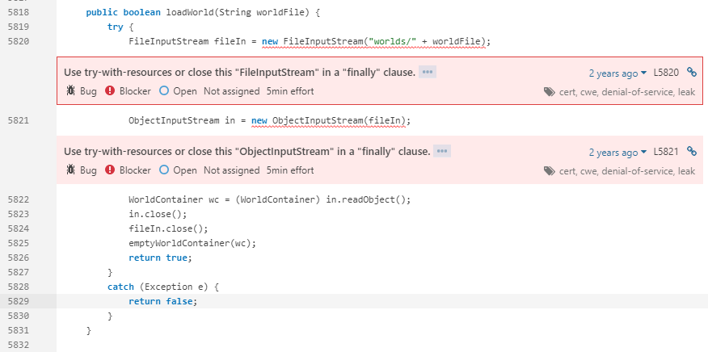
Memory leak

Slide 10
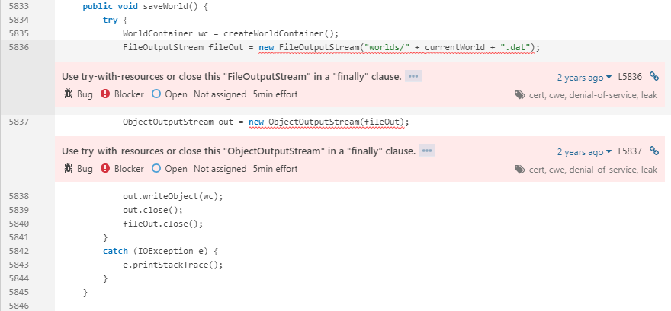
Memory Leak 2

Slide 11
Single Responsibility
Goes against SOLID principle.
Unconventional class sizes.

